Slide 1
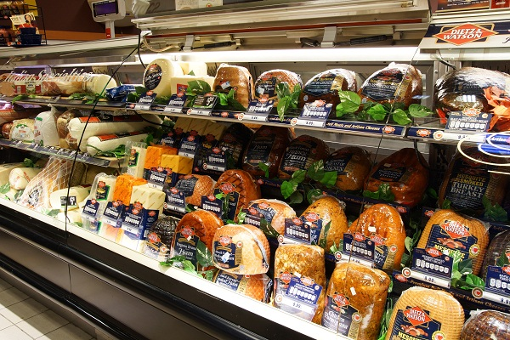
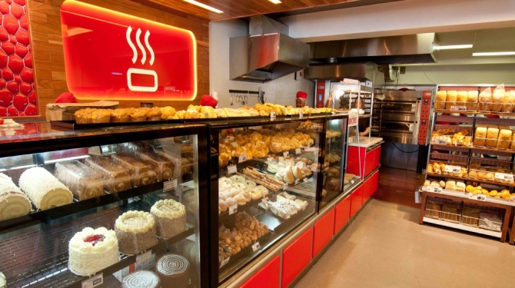
POS INVENTORY
Made By:- Easovation Solutions

Slide 2
About POS Inventory
Pos Inventory Software deals with selling of any products in order to complete retail transaction with invoice print.
It provide easy process of purchasing more products for customers.
It Comes with online purchases of product through android app.
It comes with user friendly GUI in both website and app.

Slide 3
Features of POS Inventory
Fast ,User friendly and light weight.
It decrease’s time for generating any type of Invoice.
Different accessible rights distribution between admin, company, store, billing counter and customer .
Real time data of today’s total revenue, Invoice generated, sell cost of company.
Graphical representation of top Items Sell and sell on different store in last 10 days .
Easier to add, update and delete any product with Image upload facility .
Fast response time during invoice generation for customer.
Software is linked with android app for online customer.
It comes with Excel, CSV, PDF and Print facility.

Slide 4
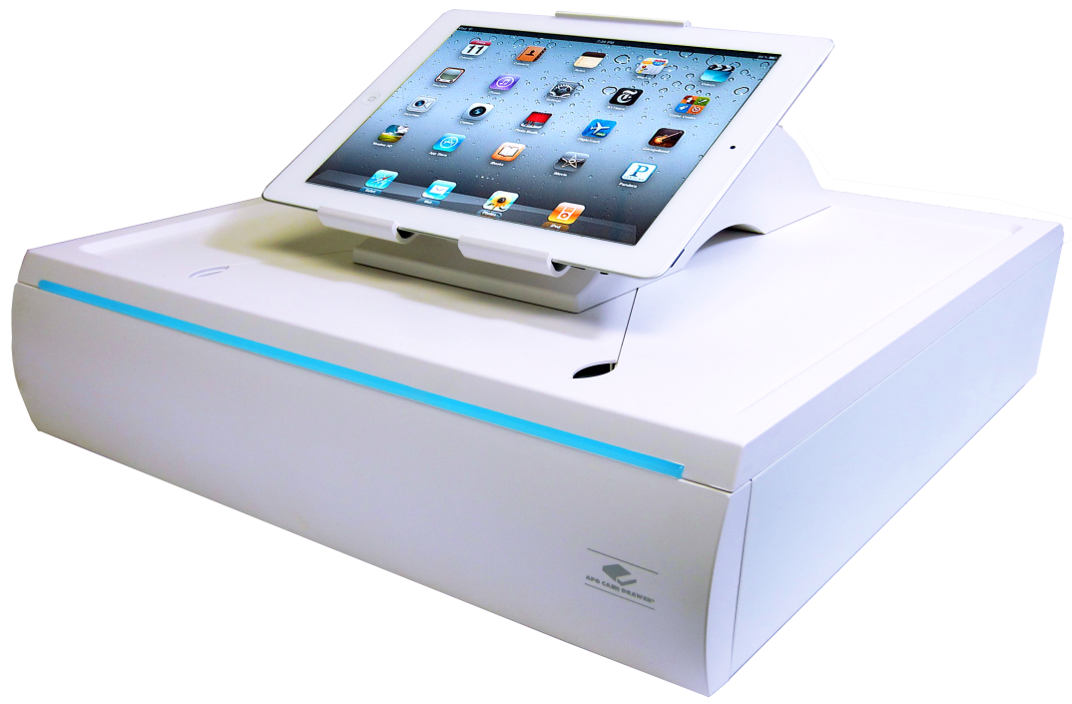
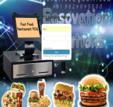
Abstract Information
Software Comes with different login systems
Admin Panel
Company panel
Store panel
Counter panel
Customer panel

Slide 5
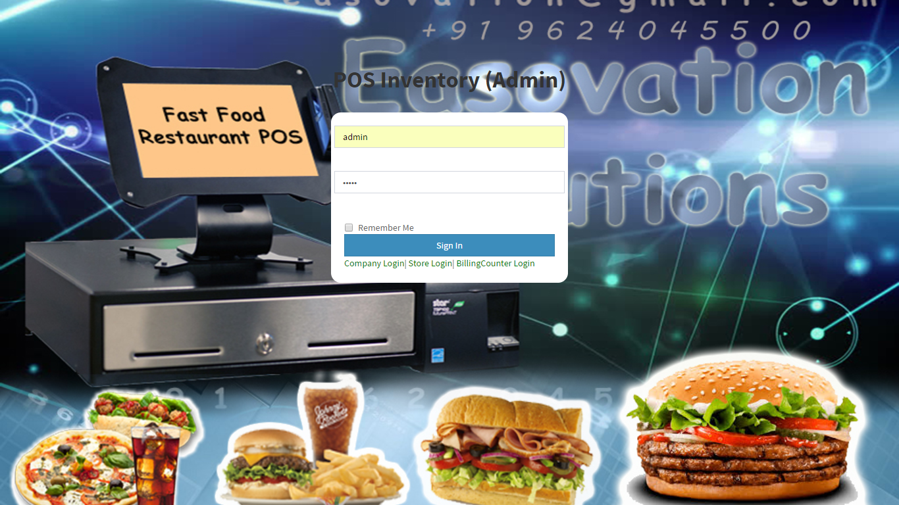
Login Panel

Slide 6
Access Rights Distribution
Admin Panel:- Admin is leader of the software having full access to account of his store, counter, customer. It can do any formal change in retail information of software.
Company Panel:- Company have rights to access store, counter, customer panel information and can alter information on it.
Store Panel:- Store have rights to access invoice data from any of billing counter panel and analyse any particular counter under his store .
Counter:- Counter having only rights to generated invoice from front end software by selecting product order for customer .
Customers :- Customer can accessing his current/previous order through android app .

Slide 7
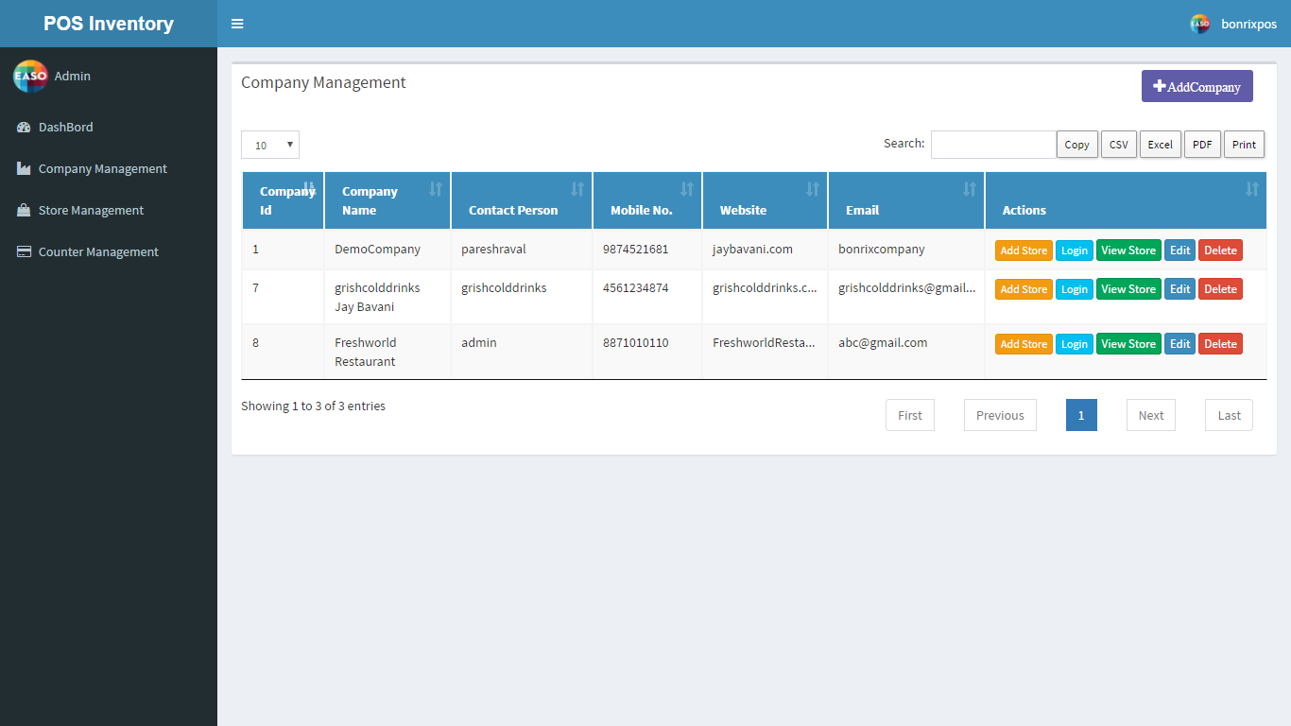
Admin Panel

Slide 8
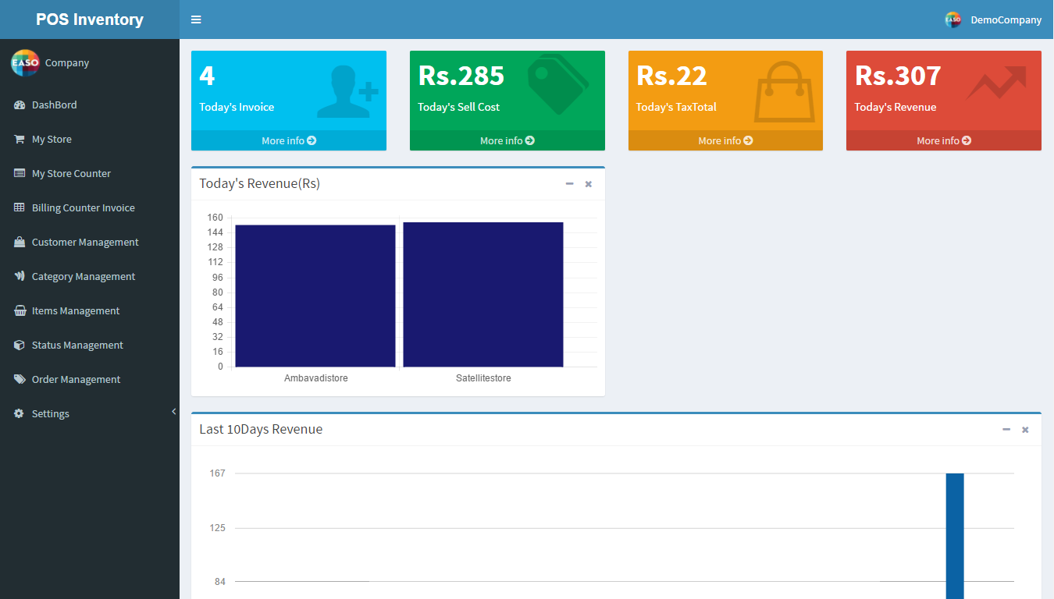
Company Panel

Slide 9
Company Management
Dashboard :- Its gives real time data of today’s invoice, sell cost, Tax Total, Revenue in numbered form .It provide graphical representation of Today’s sale revenue store wise . It also provide last 10 days company revenue store wise.
My store:- In which person can view all store present in our company with view counter facility . It has login access to store counter.
My Store Counter:- It provides view of Billing counter present in all store’s . View invoice from particular counter.
Billing Counter Invoice:- This menu comes with search option between any two dates for finding number of invoice generated from different counter from particular store. It provides information of all products from which invoice generated from different billing counter.

Slide 10
Company Panel Screens

Slide 11
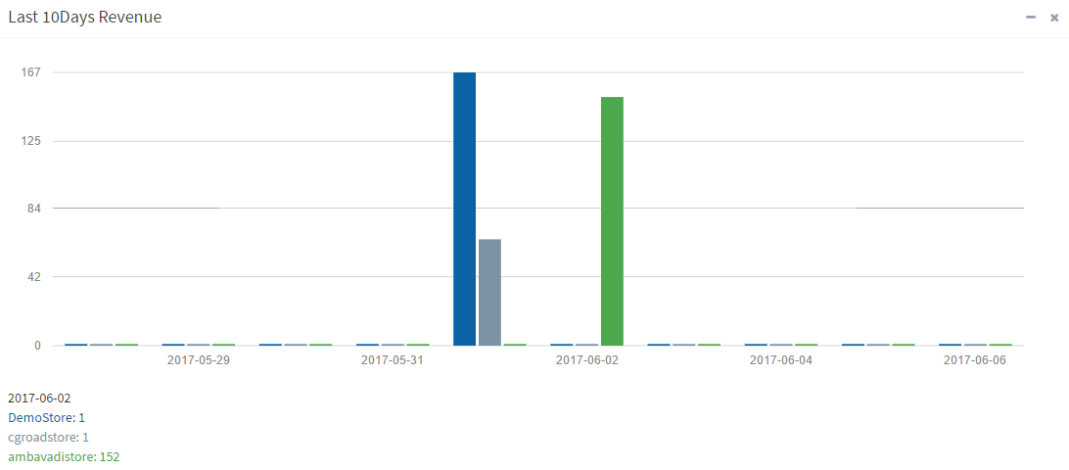
Graphical Presentation

Slide 12
Customer Management:- It gives data for all customer who register through android app . It comes with send sms(short message service ) and add order facility . It give (optional) login access to customer panel.
Category Management:-In this person can Add, Update, Edit and Delete any category of his/her company . It also comes with image upload facility.
Items Management: - It comes with Adding Items to respective category of items with image upload facility .It also edit/delete facility.
Status Management:- In this We can Add Any Status for order made by customer through android app. And helps on send sms to customer.

Slide 13
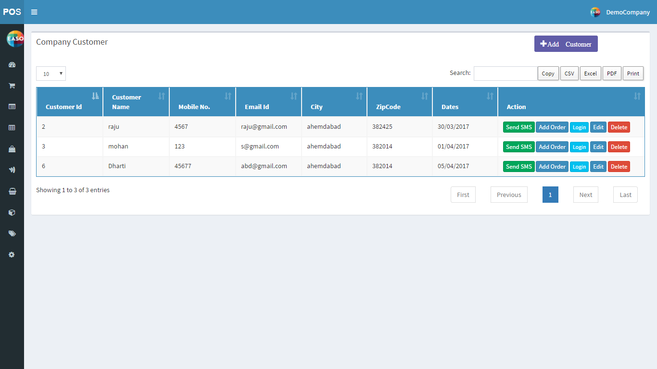
Customer Management Screen

Slide 14
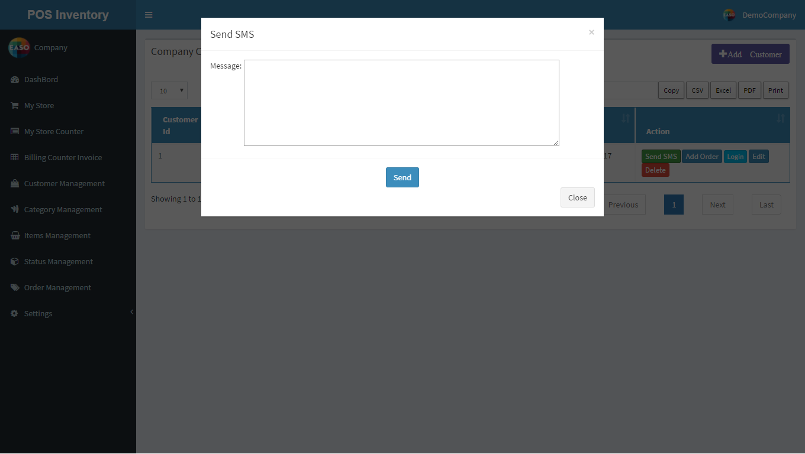
Send SMS Dialog Box

Slide 15
Settings:-
SMS Template:- It comes with adding SMS format for sending sms to customer.
SMS URL: – An Api for sending SMS to Customer regarding current status of order .
Bill Template:- An format for printing invoice for items purchase by customer.

Slide 16
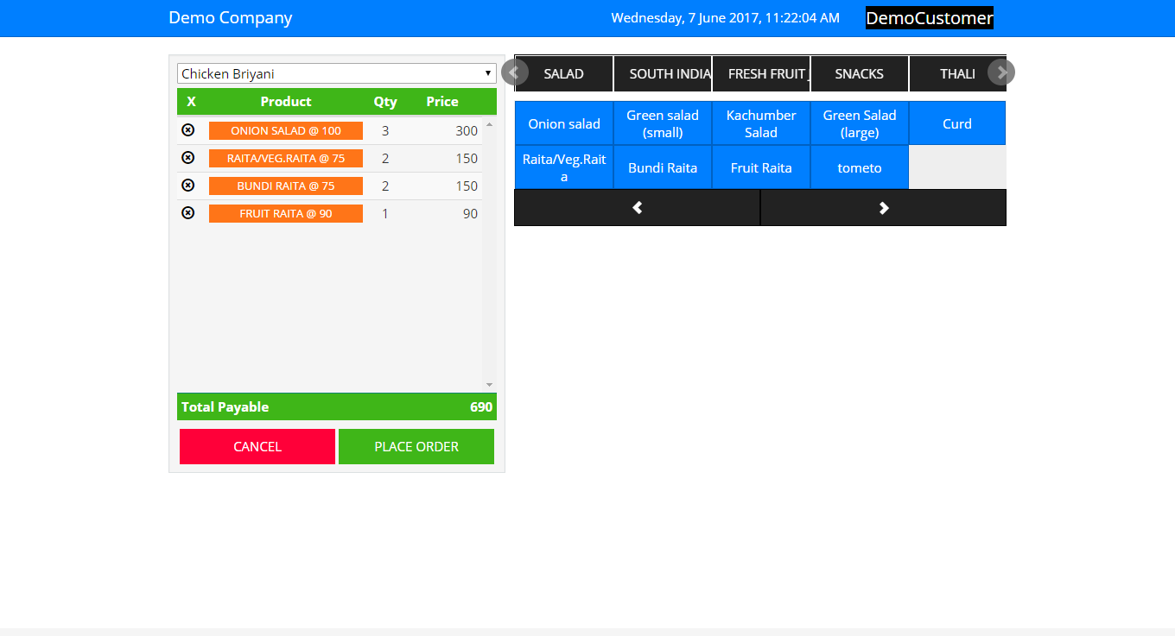
ADD Order UI

Slide 17
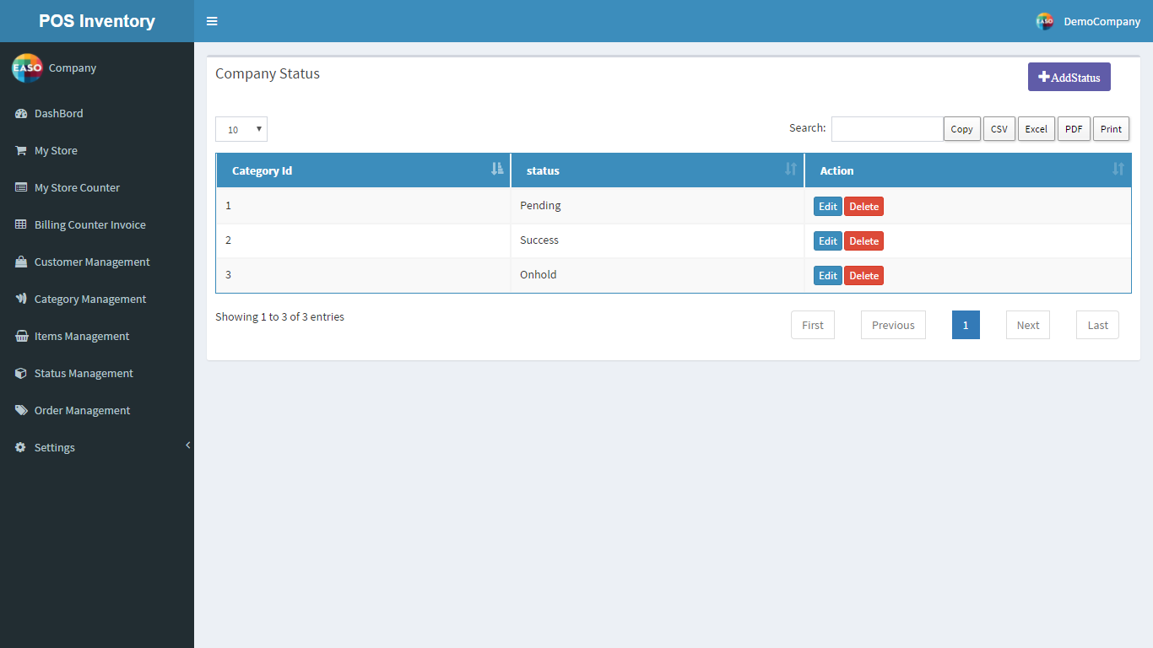
Status Management

Slide 18
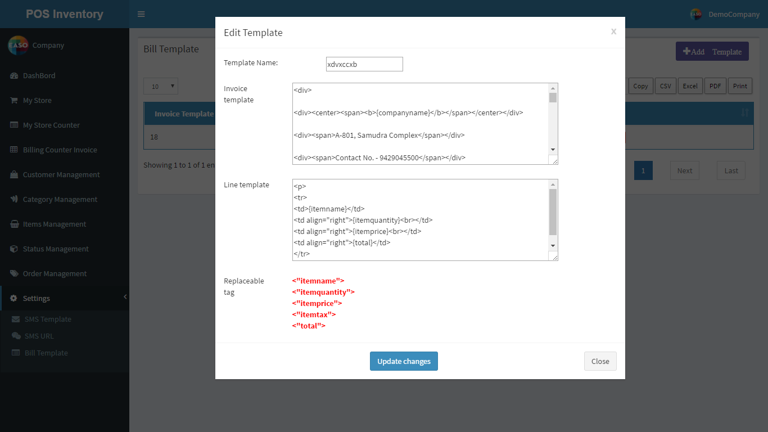
Invoice Format

Slide 19
Store Management
My Counter: - It show details of all present in his store with contact detail.
Counter invoice:-It gives invoice made from particular counter with view product facility.

Slide 20
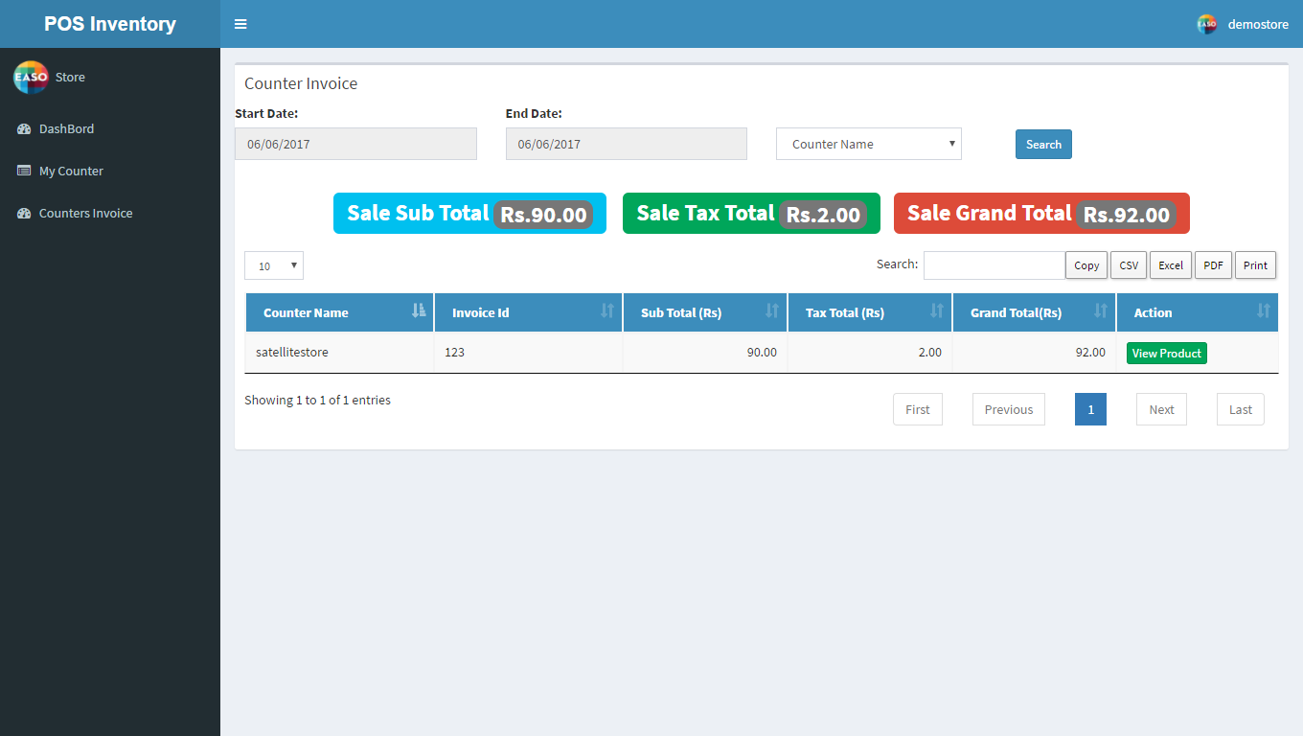
Billing Invoice

Slide 21
Billing Counter Management
It is the last stage of software which direct communicate with customers.
It generates final Invoice of order.
My Counter: - It show details of all present in his store with contact detail.
Counter invoice:-It gives invoice made from particular counter with view product facility.

Slide 22
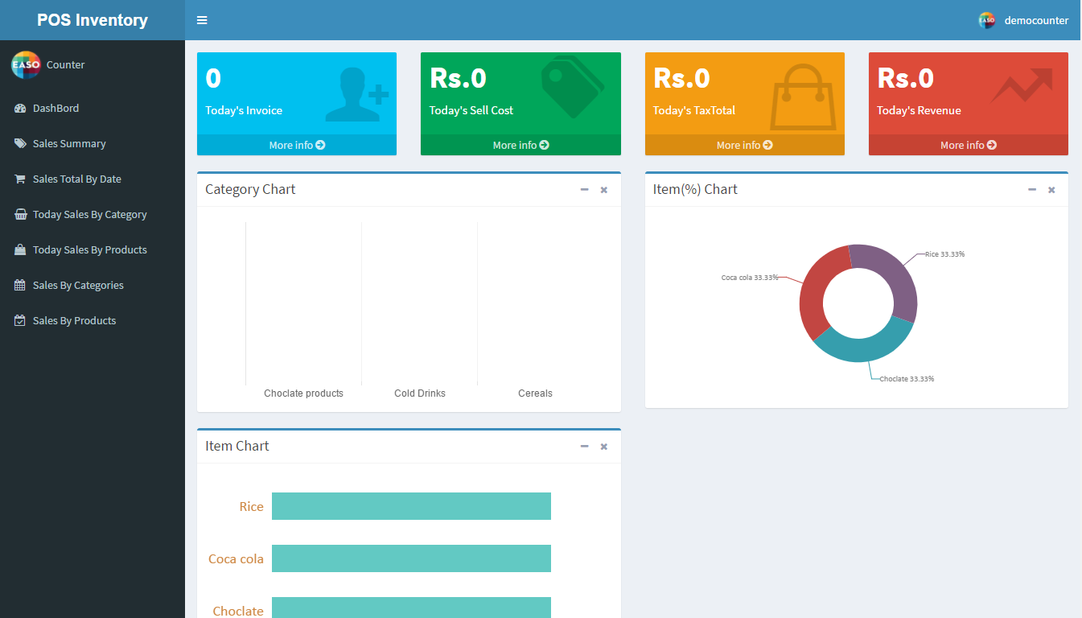
Billing Counter Dashboard

Slide 23
Last 30 Days Revenue(Graph)

Slide 24
Key Points
A detail analysis of date wise revenue with total sell cost of all Products .
All Panels comes with pagination facility to get limited number of data as per needs.
Invoice print works with all types of printer including.

Slide 25
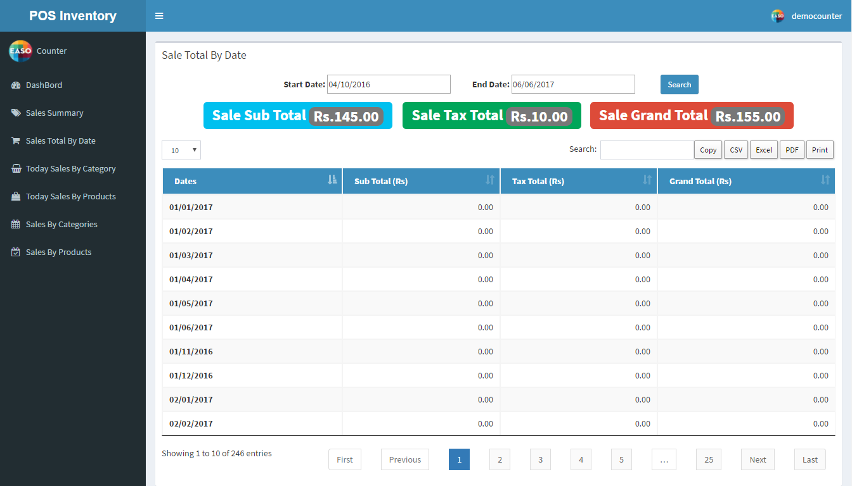
Date Wise Revenue

Slide 26
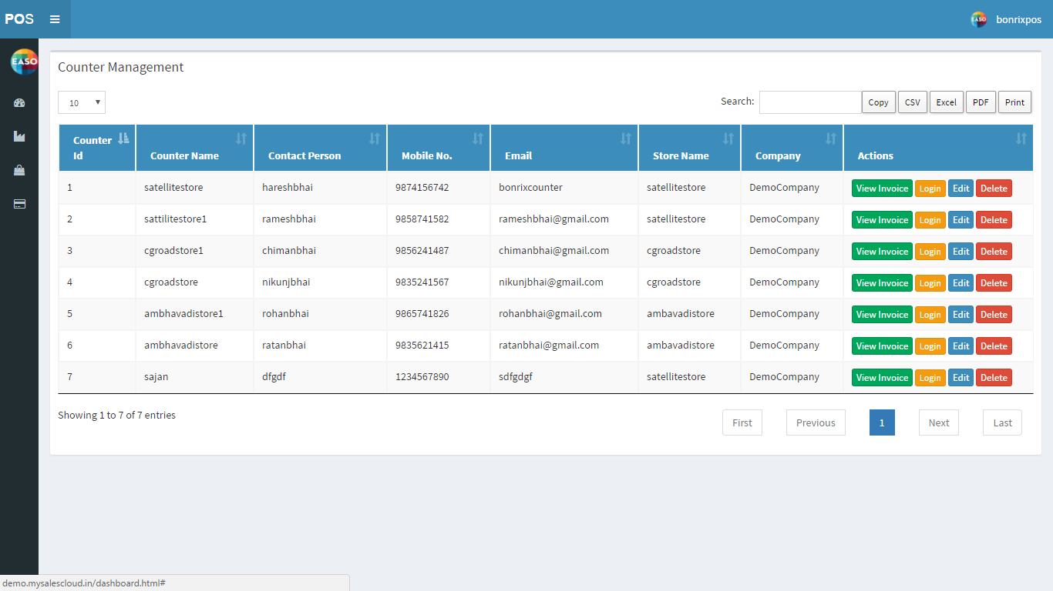
Admin Counter

Slide 27
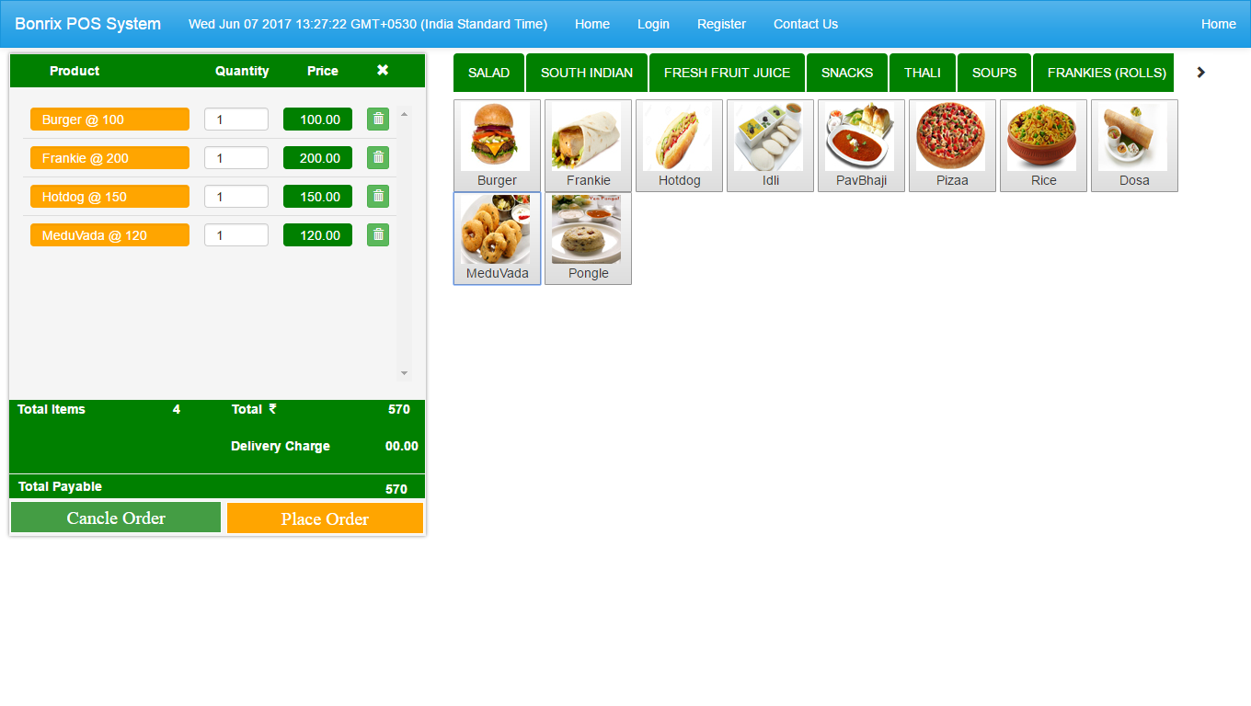
The Billing Counter UI

